Slide 1
SETS national movement evaluation questionnaires - Results - June 2023
© PRAIS Foundation, 2023

Slide 2
IN SHORT SETS
IMPACT STUDY OUTCOMES
JUNE 2023
99.5% of the respondents considered the project’s activities to have a positive impact related to the pupils’ heathy lifestyle habits.
Participation to SETS Healthy Sandwich Activity was preferred by 91.8% this year.
93.4% of the participants became members of the new SETS Facebook Private Group.
99.8% of the teachers considered to be beneficial to continue the SETS national movement in order to improve pupils’ knowledge about the importance of a healthy lifestyle.
4,758 HOURS were allocated to SETS extracurricular activities in 16 weeks of school;
© PRAIS Foundation, 2023

Slide 3
Objectives
To assess the impact and effectiveness of the "I’m living healthy, too!" - SETS national movement between January - June 2023.
To assess the power of mobilization through the use of our digital methodologies that has led to a significant impact among the SETS pupils.
© PRAIS Foundation, 2023

Slide 4
METHODOLOGY
RESEARCH TYPE
SELF-COMPLETION ONLINE
ACTIVE TEACHERS INVOLVED IN THE PROJECT FROM OVER 93 CITIES AND COMMUNITIES FROM 14 COUNTIES
RESEARCHED POPULATION
SAMPLE SIZE
N= 438 QUESTIONNAIRES, FROM 450 ACTIVE TEACHERS ➔ 98% COMPLETION RATE
GENERAL CONSIDERATIONS
DATA COLLECTION PERIOD: MAY - JUNE 2023
QUESTIONNAIRE
DRAFTED BY THE PRAIS FOUNDATION
© PRAIS Foundation, 2023

Slide 5
RESULTS
© PRAIS Foundation, 2023

Slide 6
Q1: Do you believe that the participation of the pupils at SETS national movement’s 2022-2023 edition helps change their lifestyle habits through access to SETS educational materials, information and extracurricular activities?
99.8% of respondents consider that pupils' participation in SETS national movement has contributed to changing their lifestyle habits through their access to SETS educational materials, information, and extracurricular activities.
YES
NO
© PRAIS Foundation, 2023

Slide 7
The parents of the pupils are very supportive of the project and, 99.5% of the teachers responded that the SETS activities and competitions are considered useful to them.
Q2: Did the parents of the pupils consider SETS activities useful and supported the children’s participation in this at home or at school during this period?
YES
NO
© PRAIS Foundation, 2023

Slide 8
4,758 HOURS
Q3: How many extracurricular hours have you allocated for carrying out the educational activities within the national movement "I’m living healthy, too!" - SETS during January – May 2023?
were allocated to SETS extracurricular activities in 16 weeks of school
© PRAIS Foundation, 2023

Slide 9
Q4: Mark the pupils’ preferred SETS activity (one or both can be marked).
Drawing activities
Healthy Snacks activities
From the 4 activities proposed to pupils, “Joyful Healthy Snacks” activity" was the most beloved, with 91.8%, followed closely by SETS Drawing activities, with 84%.
Gym Class
SETS eBook Open Lessons
© PRAIS Foundation, 2023

Slide 10
Q5: Did your pupils participate in the SETS drawing contest with the theme “The stories of my preferred water, fruits and vegetables!"?
Q5.1: 90.8% of respondents whose pupils participated in the SETS drawing contest say that the chosen topic was very good for promoting the importance of hydration, fruit, and vegetable consumption among the pupils.
YES
NO
Modest
Very
good
© PRAIS Foundation, 2023

Slide 11
Q6.1: 91.7% of respondents whose pupils participated in the SETS activity say that the SETS activity was very good for promoting the importance of fruit and vegetable consumption among the pupils.
Q6: Did your pupils participate in the SETS activity "The Happy and Healthy Sandwich" within the SETS movement?
YES
NO
Modest
Very
good
© PRAIS Foundation, 2023

Slide 12
Q6.1: 89.3% of respondents whose pupils participated in SETS activity say that the SETS activity was very good for promoting the importance of physical activities among pupils.
Q7: Did your pupils participate in the SETS activity “Gym Class" within the SETS movement?
YES
NO
Modest
Very
good
© PRAIS Foundation, 2023

Slide 13
Q8: How do you evaluate the educational short movies created specifically to promote the importance of adopting a healthy lifestyle based on fruit and vegetable consumption, hydration, daily physical activity and quality time spent with loved ones?
87.9% of respondents evaluated very good the educational short movies.
Modest
Very
good
© PRAIS Foundation, 2023

Slide 14
Q8.1: To what extent were these useful and inspired the pupils to adopt a balanced lifestyle?
82.9% of respondents evaluated them as very useful and believed they inspired pupils to adopt a balanced lifestyle.
Little
useful
Very
useful
© PRAIS Foundation, 2023

Slide 15
Q9: How do you evaluate the content of the E-book "The well-being of children, a priority", from the point of view of the recommendations offered by specialists?
86.1% of respondents evaluated the content of the E-book as very good.
Very
good
Modest
© PRAIS Foundation, 2023

Slide 16
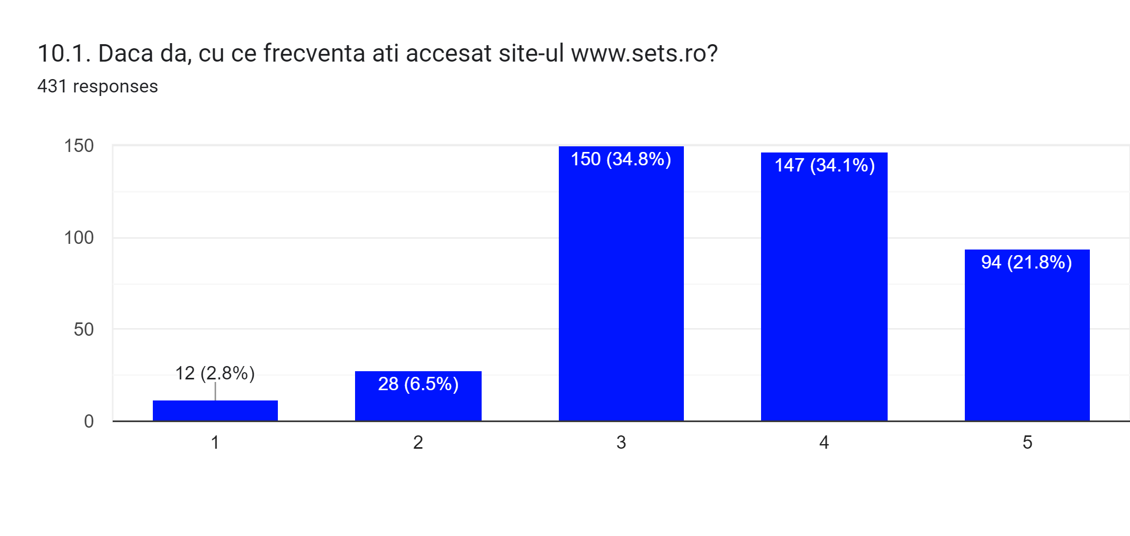
Q10.1: If so, how often did you access the website www.sets.ro?
On a scale from 1 (only once) to 5 (very frequently) 55.9% accessed often and very often.
Q10: Have you accesed www.sets.ro, the website of the movement?
98.6% of respondents accessed the SETS website.
YES
NO
only once
very frequently
© PRAIS Foundation, 2023

Slide 17
Q10.2: If so, how do you evaluate the structure and informative content of www.sets.ro?
On a scale from 1 (modest) to 5 (very good) 74.9% evaluated the structure and informative content as very good.
modest
very good
© PRAIS Foundation, 2023

Slide 18
Q11.1: If so, how often did you access the Facebook page @MiscareaSETS?
On a scale from 1 (only once) to 5 (very frequently) 79.4% accessed the FB page often and very often.
Q11: Have you accessed the movement’s Facebook page @MiscareaSETS?
90.1% of respondents accessed the SETS website.
YES
NO
only once
very frequently
© PRAIS Foundation, 2023

Slide 19
Q11.2: If so, how do you evaluate the structure and informative content of the Facebook page @MiscareaSETS?
On a scale from 1 (modest) to 5 (very good) 79.1% evaluated the structure and informative content as very good.
very good
modest
© PRAIS Foundation, 2023

Slide 20
Q12: Are you a member of the SETS Facebook Private Group?
Q12.1: Did you promote pupils’ activities on the SETS Facebook Private Group?
YES
NO
© PRAIS Foundation, 2023

Slide 21
Q12.2: If so, how do you evaluate this new promotion platform: SETS FB Private Group?
On a scale from 1 (modest) to 5 (very good) 74.5% evaluated the SETF FB Group as very good.
modest
very good
© PRAIS Foundation, 2023

Slide 22
Q13: Do you think it would be beneficial to continue the SETS national movement to improve pupils' knowledge on the importance of a healthy lifestyle?
99.8 % of respondents consider to be beneficial to continue SETS national movement in order to improve pupils’ knowledge about the importance of a healthy lifestyle.
YES
NO
© PRAIS Foundation, 2023

Slide 23
Q14: How do you evaluate the involvement of children in the activities of this edition of the SETS movement?
On a scale from 1 (reticent) to 5 (very enthusiastic) 81.7% evaluated the involvement of children in SETS activities as very enthusiastic.
reticent
very enthusiastic
© PRAIS Foundation, 2023

Slide 24
Q15: Geographic region of SETS 2023 participants:
© PRAIS Foundation, 2023

Slide 25
Following the answers of the open-ended question, this is what the respondents had to say about the SETS national movement.
25
25
25
25
25
25
25
25
25
25
© PRAIS Foundation, 2023

Slide 26
"Both the kids and I enjoyed the activities and we can't wait to participate in more."
"It is the third year that I participate with the children. It was wonderful, and the children enjoyed every activity."
“A very good collaboration, an interesting experience for both the children and for me and the parents, an initiative that will change our lives for the better!"
"Very useful materials, the information provided is also applicable during the course hours. Interesting activities, which aroused the students' curiosity, and they got involved with enthusiasm. Congratulations!"
“The proposed activities, the materials made available, the attractive themes, EVERYTHING gives us the opportunity to say: Thank you! You are amazing!"

Slide 27
WE WILL CONTINUE TOGETHER!

